Slide 1
Predicting Student performance
Anuj Yadav(1803211012)
Anurag Yadav(1803211013)
Faisal Khan(1803211019)
Guide- Ms. Shelly Gupta
Department- CEIT
ABES EC, Ghaziabad
Affiliated to Dr. A.P.J. Abdul Kalam Technical University, Uttar Pradesh, Lucknow

Slide 2
Objective:
The Objective of this project is to improve prediction techniques regarding the future performance of students in select courses through the utilization of multiple machine learning algorithms.

Slide 3
Introduction:
Prediction of student academic performance has long been regarded as an important research topic in many academic disciplines because it benefits both teaching and learning.
That is essential in order to help at-risk students and assure their retention, providing the excellent learning resources and experience
Instructors can use the predicted results to identify the number of students who will perform well, averagely, or poorly in a class.
we will create a methodology to build a student’ performance prediction model using a supervised machine learning technique.

Slide 4
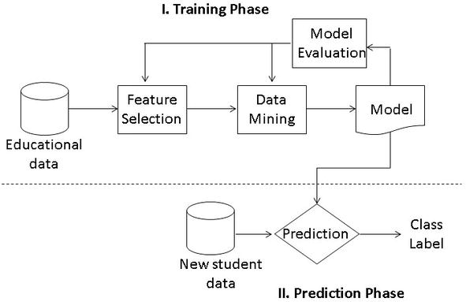
Methodology:

Slide 5
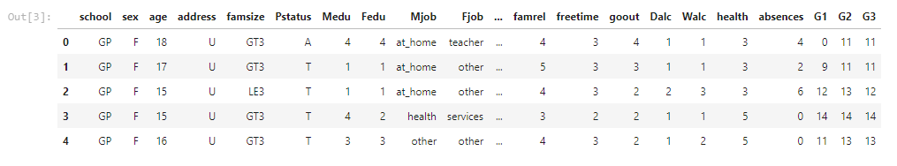
Dataset used:
The dataset is from UCI Repository.
The dataset Contains 395 rows and 33 columns.

Slide 6
DataSet Attributes:
id - student's id
sex - student's sex (binary: 'F' - female or 'M' - male)
age - student's age (numeric: from 15 to 22)
address - student's home address type (binary: 'U' - urban or 'R' - rural)
famsize (binary: 'T' - living together or 'A' - apart)
Medu - mother's education (numeric: 0 - no- family size (binary: 'LE3' - less or equal to 3 or 'GT3' - greater than 3)
Pstatus - parent's cohabitation status ne, 1 - primary education (4th grade), 2 - 5th to 9th grade, 3 - secondary education or 4 - higher education)

Slide 7
Dataset Attributes
Fedu - father's education (numeric: 0 - none, 1 - primary education (4th grade), 2 - 5th to 9th grade, 3 - secondary education or 4 - higher education)
Mjob - mother's job (nominal: 'teacher', 'health' care related, civil 'services' (e.g. administrative or police), 'at_home' or 'other')
Fjob - father's job (nominal: 'teacher', 'health' care related, civil 'services' (e.g. administrative or police), 'at_home' or 'other')
reason - reason to choose this school (nominal: close to 'home', school 'reputation', 'course' preference or 'other')
guardian - student's guardian (nominal: 'mother', 'father' or 'other')
traveltime - home to school travel time (numeric: 1 - <15 min., 2 - 15 to 30 min., 3 - 30 min. to 1 hour, or 4 - >1 hour)
studytime - weekly study time (numeric: 1 - <2 hours, 2 - 2 to 5 hours, 3 - 5 to 10 hours, or 4 - >10 hours)
failures - number of past class failures (numeric: n if 1<=n<3, else 4)

Slide 8
Dataset Attributes
schoolsup - extra educational support (binary: true or false)
famsup - family educational support (binary: true or false)
paid - extra paid classes within the course subject (binary: true or false)
activities - extra-curricular activities (binary: true or false)
nursery - attended nursery school (binary: true or false)
higher - wants to take higher education (binary: true or false)
internet - Internet access at home (binary: true or false)
romantic - with a romantic relationship (binary: true or false)
famrel - quality of family relationships (numeric: from 1 - very bad to 5 - excellent)
freetime - free time after school (numeric: from 1 - very low to 5 - very high)
goout - going out with friends (numeric: from 1 - very low to 5 - very high)
Dalc - workday alcohol consumption (numeric: from 1 - very low to 5 - very high)
Walc - weekend alcohol consumption (numeric: from 1 - very low to 5 - very high)
health - current health status (numeric: from 1 - very bad to 5 - very good)
absences - number of school absences (numeric: from 0 to 93)
G1, G2 – Mid term grade
G3 - the final grade (numeric: from 0 to 20, output target)

Slide 9
Implementation(done till now)
Gathered the dataset.
Done Data PreProcessing.
Tried to do some visualisation by finding which attributes are affecting the grades.
Removing the attributes which does not affect Grades.
Applied KNN and Logistic Regression to predict whether the student would pass or fail.

Slide 10
Future Work
We will try to find some more insights from the dataset.
We will try to learn some new Data Mining techniques and try to implement it.
We will try to increase accuracy as much as possible.
After all these we will try to create a dashboard.

Slide 11
References
https://www.researchgate.net/publication/334109444_Performance_Analysis_and_Prediction_Student_Performance_to_build_effective_student_Using_Data_Mining_Techniques
Sayana T S, 2015, Prediction of Students Academic Performance using Data Mining: Analysis, INTERNATIONAL JOURNAL OF ENGINEERING RESEARCH & TECHNOLOGY (IJERT) RTPPTDM – 2015 (Volume 3 – Issue 30)
C. -C. Kiu, "Data Mining Analysis on Student’s Academic Performance through Exploration of Student’s Background and Social Activities," 2018 Fourth International Conference on Advances in Computing, Communication & Automation (ICACCA), 2018, pp. 1-5, doi: 10.1109/ICACCAF.2018.8776809.

Slide 12
THANK YOU

